Slide 1
The A-Team | Agile Communication Project
Presented by: Christopher O’Hara, PhD

Slide 2
Agile Communication
Project
Sprints 1-3

Slide 3
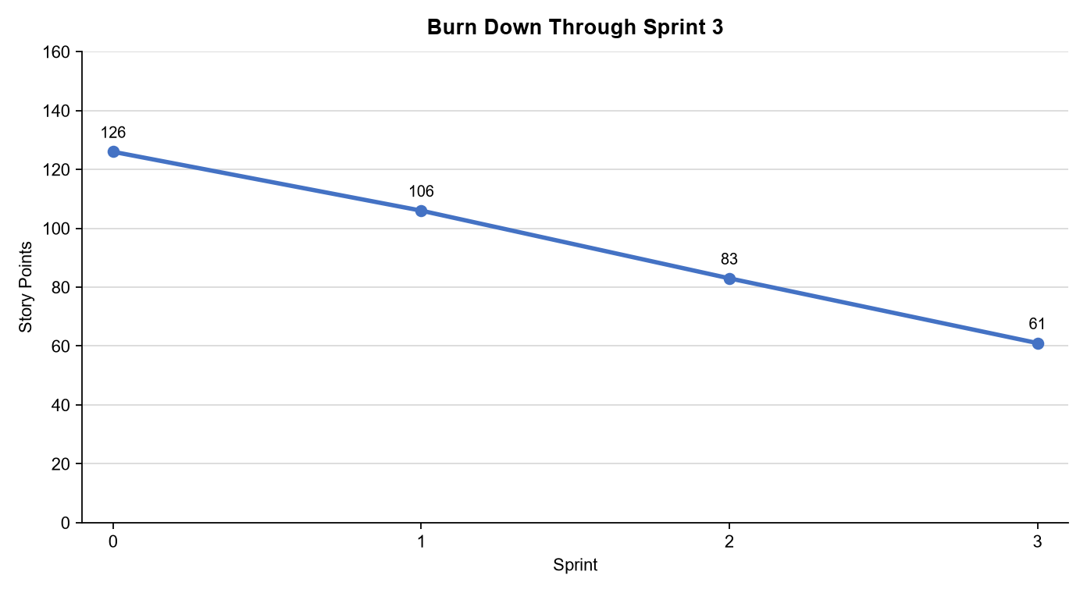
Sprints 1-3 Questions
What is your Velocity for the past 3 sprints?
Delivered velocity: 20, 23, and 22 points; average 21.7 points per sprint.
How do you know your Velocity is correct?
The total comes from completed story-point sums in the User Stories sheet and agrees with the burn charts: 65 cumulative points completed after Sprint 3.
What would the BURN DOWN chart look like for Sprints 1-3?
See Chart
What would the BURN UP charts look like for Sprints 1-3?
See Chart
How many points do you think the Team should commit to for Sprint 4 and justify your answer?
Commit 22 points. It is near the three-sprint average, fits sustainable pace, and leaves room for the newly urgent security work without treating capacity as a promise.

Slide 4
Agile Communication
Project
Sprint 4 | Cyber Shield

Slide 5
Snapshot at end of Sprint 4

Slide 6
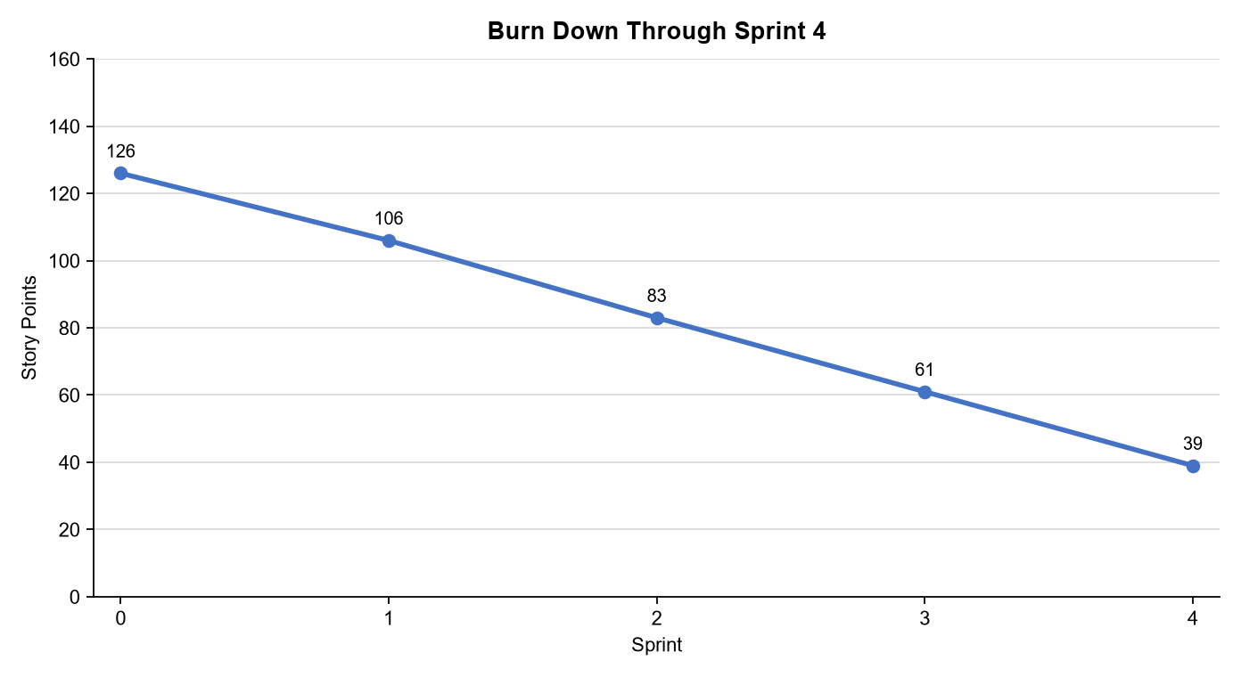
Sprint 4 Questions
What would the BURN DOWN chart look like for Sprints 1-4?
See Chart
What would the BURN UP charts look like for Sprints 1-4?
See Chart
What Risks did you identify in Sprint 4 and how do they affect the project? (Note: These would be your narrative findings)
Cybersecurity is the immediate risk: a vulnerability could expose customer data and delay the beta. We moved Sam's 13-point scan and 8-point secure Git access ahead of lower-value work; the 1-point approval story brings the sprint to 22 points.
What Theme or Name did you give to Sprint 4?
Theme: Cyber Shield - secure the customer path before expanding lower-priority capability.

Slide 7
The A-Team
Sprint 4 Name Cyber Shield
User Stories in Sprint 4 1. Story 15 - vulnerability scan (13) 2. Story 21 - secure Git access (8) 3. Story 19 - software approval (1) Total Sprint 4 Points: 22
Narrative: Stakeholder security concern reordered the backlog. Results: 22/22 points delivered; security scan capability is in the MVP path. Learnings: Transparent metrics made the trade-off visible. Risks: Scan findings may require remediation before canary release.
SPRINT 4 DEMO of Working Product

Slide 8
Agile Communication
Project
The A-Team | Sprint 5

Slide 9
Snapshot at end of Sprint 5

Slide 10
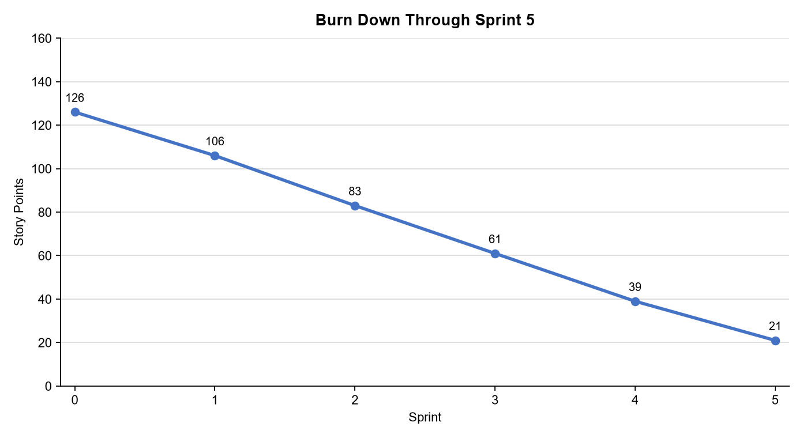
Sprint 5 Questions
What would the BURN DOWN chart look like for Sprints 1-5?
See Chart
What would the BURN UP charts look like for Sprints 1-5?
See Chart
What Risks did you identify in Sprint 5 and how do they affect the project? (Note: These would be your narrative findings)
The performance story, 99.99% availability, and review moderation total 23 points. The burn-up rises from 87 to 110 points; burn-down falls from 39 to 21 after the 5-point responsiveness request is added in Sprint 5.
How confident are you in delivering all of the user stories by the end of Sprint 6? Justify your answer.
Risk: customer abandonment remains possible until responsiveness is demonstrated under load; availability work may reveal integration constraints. Mitigation: test response time and availability before the Sprint 6 planning event.

Slide 11
The A-Team
Sprint 5 Name Customer Fast Lane
User Stories in Sprint 5 1. Story 22 - responsiveness (5) 2. Story 18 - 99.99% availability (13) 3. Story 14 - review moderation (5) Total Sprint 5 Points: 23
Narrative: Edith's feedback became the highest remaining priority. Results: 23/23 points delivered; customer experience and reliability improved. Learnings: Sprint review is a feedback loop, not a sign-off. Risks: Validate performance under realistic load before canary.
SPRINT 5 DEMO of Working Product

Slide 12
Agile Communication
Project
The A-Team | Sprint 6

Slide 14
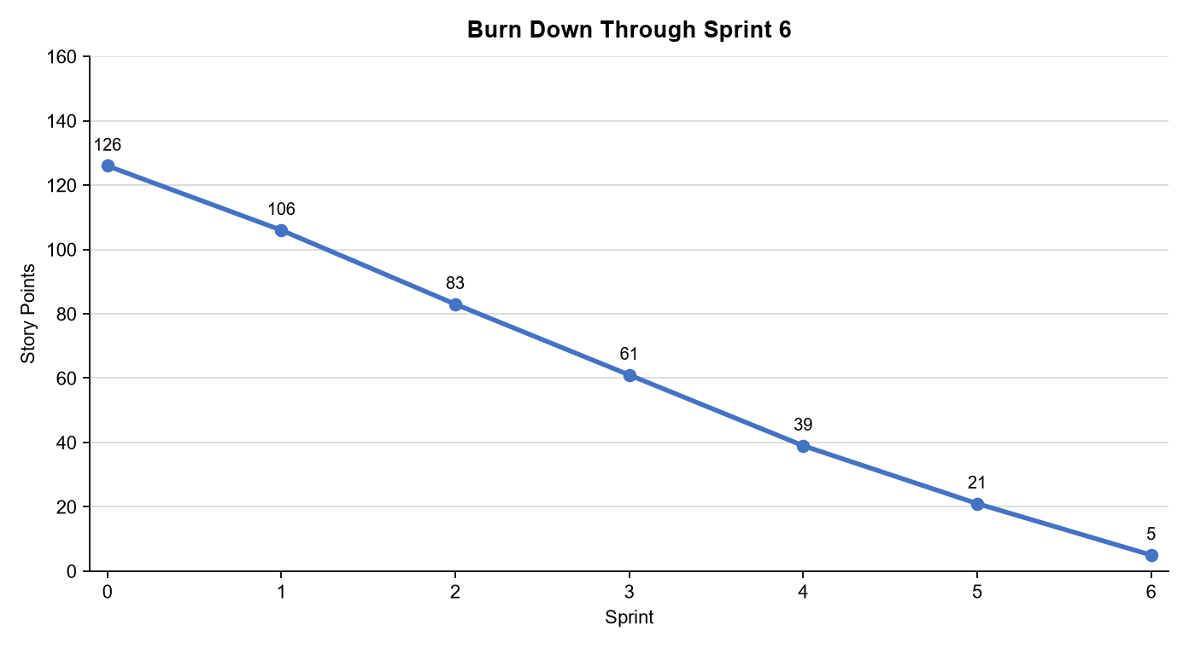
What would the BURN DOWN chart look like for Sprints 1-6?
See Chart
What would the BURN UP charts look like for Sprints 1-6?
See Chart
Was the Team able to complete all the work in the backlog or did you have to adjust what could be delivered? How would you tell this to Management and justify your answer.
Sprint 6 delivers 21 points: BOGO (5), sales-trend reporting (8), and developer setup (8). The project completes 131 of 136 total points. The five-point customer-review analysis story is deferred, not hidden. Management should release the validated MVP beta via the planned 10% automatic canary and 90% opt-in path, then decide on broader rollout from evidence.

Slide 15
The A-Team
Sprint 6 Name Flash Sale Launch
User Stories in Sprint 6 1. Story 23 - 30-day BOGO (5) 2. Story 16 - sales trends (8) 3. Story 20 - developer setup (8) Total Sprint 6 Points: 21
Narrative: The pandemic-driven BOGO request is the top remaining item. Results: 21 points delivered; 131/136 points complete. Learnings: MVP scope is value-based, not every backlog item. Risks: Customer-review analysis remains deferred and monitored after beta.
SPRINT 6 DEMO of Working Product

Slide 16
BVIR for Management Questions
Which charts would you want to include in the BVIR that Management would need and why?
Move the Orange boxes to the correct column below
Include the Burn-Up, Burn-Down, and Committed vs. Delivered charts. The Burn-Up chart shows cumulative completed value and remaining scope; the Burn-Down chart shows the pace at which remaining work is declining; and Committed vs. Delivered shows the team’s reliability against its sprint commitments. Together, these metrics help Management assess progress, predictability, scope, and release readiness. Do not include Story Point Cost per Team because it does not explain MVP value, delivery progress, or the canary-release decision.
Included
Not included
Burn Down Charts
Story Point Cost per Team
Burn Up Charts
Committed vs. Delivered Chart

Slide 17
Creating the BVIR for Management
Questions to answer before you start the BVIR
What would tell Management if they want to know the details about actual stories?
[Select from the choices below]
"While I understand that you want to get into individual stories and know all the details, we would prefer that Management spends your valuable time guiding and influencing the Roadmap and direction of the project and leave the story delivery to the Teams you have empowered."
Absolutely, let's get into the details!
No, that is none of your business
Which of the above did you choose (1,2,3) and why?
Choice 1. Management receives delivery trends, scope, risk, and roadmap decisions; the empowered team owns story-level execution details.

Slide 18
Creating the BVIR for Management
Questions to answer before you start the BVIR
Is it project considered a failure because backlog items still remain? Explain.
No. A backlog is an ordered set of options, not a contract to complete every item. The MVP is successful when it delivers the validated, highest-value scope safely. One five-point analysis story remains and is transparently queued for the next decision.

Slide 19
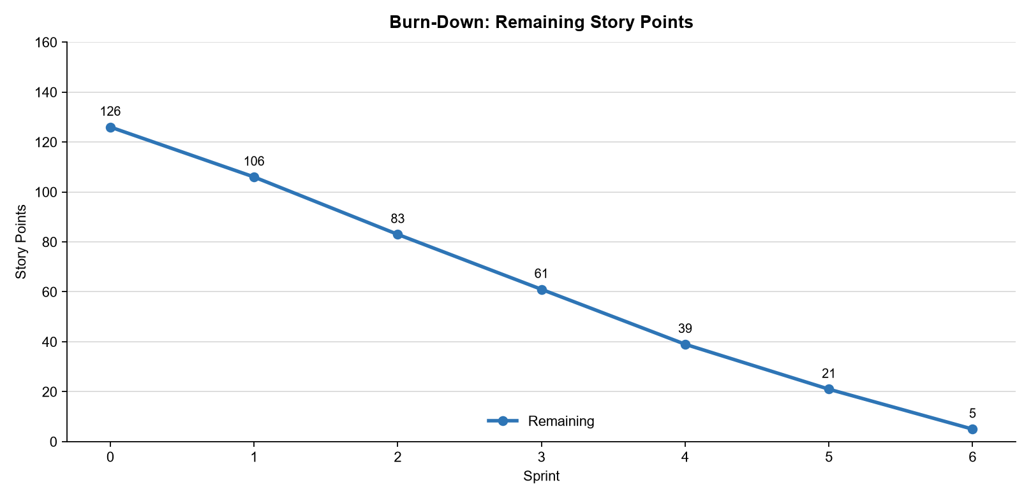
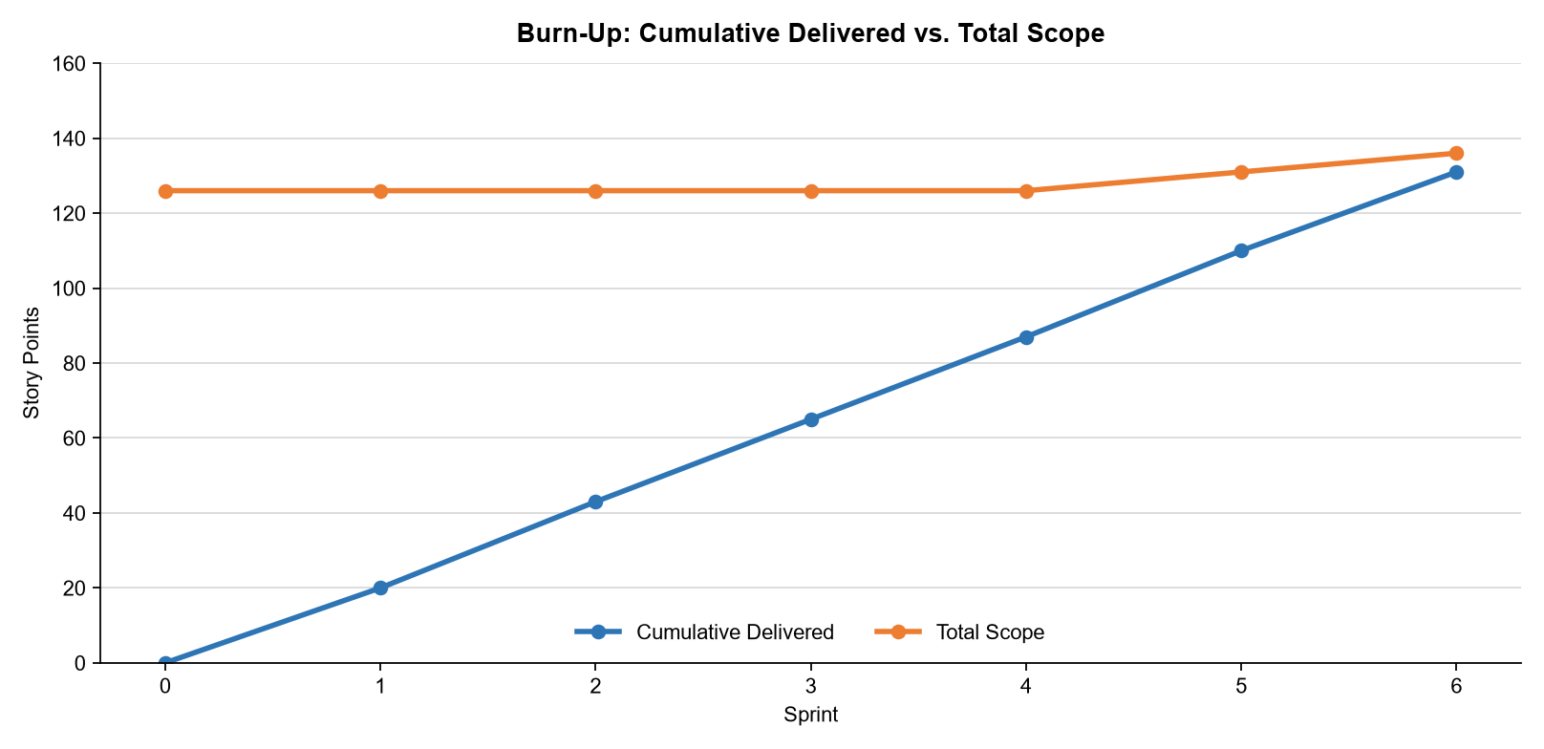
BVIR for Management
THE A-TEAM MANAGEMENT BVIR
Vision: Deliver a secure, responsive, cloud-ready website that lets customers discover and purchase software with confidence.
Status: 131 / 136 story points complete (96%). MVP beta is ready for a controlled canary, subject to final security and performance validation.
Roadmap: S1-S3 core commerce (65 points); S4 Cyber Shield (22); S5 Customer Fast Lane (23); S6 Flash Sale Launch (21).
Decision: Release to 10% automatically and offer the new site to the other 90%; monitor customer experience, security findings, availability, and BOGO behavior before full rollout.
Scope: One 5-point customer-review analysis story is deferred to the next prioritized backlog decision.

Slide 20
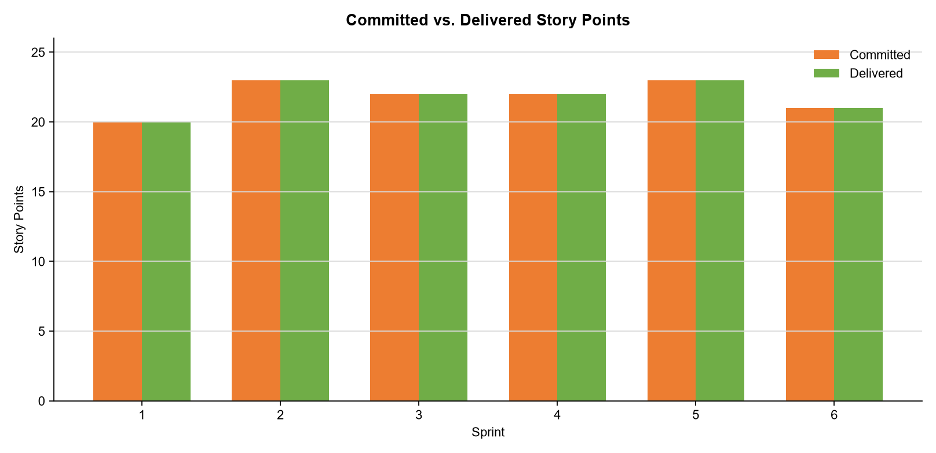
BVIR for Management
THE A-TEAM MANAGEMENT BVIR
Burn-Down: Scope was 126 at Sprint 0, remained historical through Sprint 4 (39 remaining), then changed only when new work entered. A 5-point responsiveness request entered in Sprint 5 and a 5-point BOGO request in Sprint 6. After 131 points were delivered, 5 points remain deferred.
Burn-Up: Cumulative completed work increased from 0 to 131 story points across six sprints. Total scope held at 126 through Sprint 4, increased to 131 in Sprint 5, and increased to 136 in Sprint 6. The team delivered the highest-priority MVP work and left one 5-point analysis story deferred.
Committed vs. Delivered: The team met its commitment in Sprints 1–5, delivering 20, 23, 22, 22, and 23 story points respectively. In Sprint 6, it committed and delivered 21; the team deliberately deferred lower-priority work rather than compromise MVP quality or sustainable pace.

Slide 21
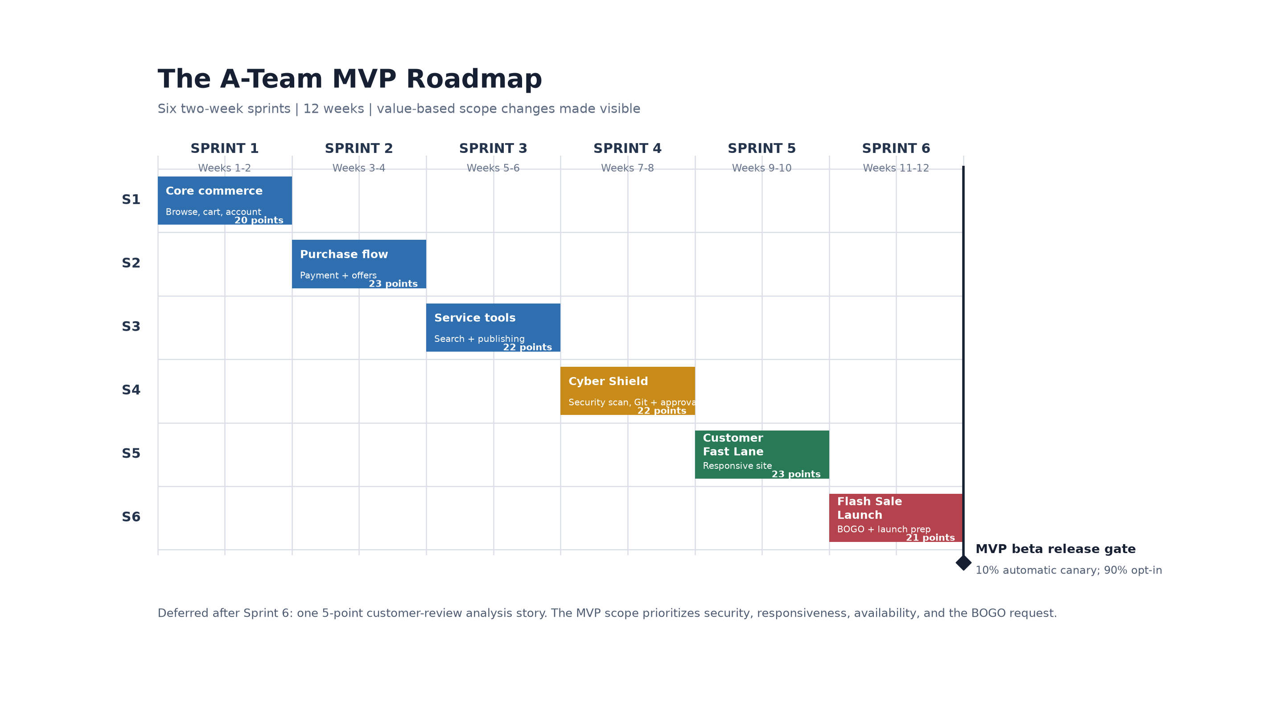

Slide 22
BVIR for Management - Written Narrative Team: The A-Team Vision: Deliver a secure, responsive, cloud-ready website that lets customers discover and purchase software with confidence. Status: 131 of 136 story points are complete (96%). The five-point customer-review analysis story is deliberately deferred. The team used an observed 21.7-point average to plan sustainably. Security work was accelerated in Sprint 4, customer responsiveness and availability in Sprint 5, and BOGO in Sprint 6. Recommendation: release the MVP beta to the planned 10% automatic canary and 90% opt-in path. Use security, performance, availability, and customer-behavior evidence before full rollout.

Slide 23
Questions from Management – Narrative (No Camera)
Responses to management questions:
CFO: An MVP is the smallest safe, usable release that tests value. We completed 131/136 points and protect customers with security, availability, and a controlled canary. Perfection is not the release criterion; validated outcomes and managed risk are.
CMO: The plan changed because customer and market learning changed. Responsiveness addressed abandonment risk and BOGO addressed the pandemic request. The backlog is adaptive; the delivered MVP preserves the highest-value work.
CEO: The Product Owner orders value and the self-managing team chooses sustainable work. Capacity averaged 21.7 points; 24/7 work would harm quality and predictability. Metrics show 96% complete and one five-point item consciously deferred.
CTO: Do not add Sprint 7 before observing the beta. Release through the 10% canary and 90% opt-in route, monitor security, performance, availability, and conversion, then reprioritize using that evidence.

